Slide 1
SOLAR
TECHNOLOGY APPLICATION RESOURCE
CENTER
Report Validation Presentation Workshop

Slide 2
Objectives of STAR-C Country Assessment and Concept for Bangladesh
undertake a country assessment for setting up a Solar Technology Application Resource Centre (STAR-C) in Bangladesh and
develop a detailed Project Report outlining the needs of Bangladesh with respect to existing activities and institutions for PV market development in compliance with the national action plan for 2041
elaborate on how to obtain more and higher skilled workforce by evaluating the training landscape and propose trainings to fill the training gaps for solar PV
assess the status of PV component testing and propose measures to increase and ease quality checks
investigate ongoing activities on knowledge generation and dissemination
screen activities for innovation and incubation with focus on SMEs and start-ups.
propose hardware and software requirements for PV training activities; implementation roadmap and a business plan for a STAR-C to generate revenue for sustenance.
Notes:
page 10: stronger = is something bright for Bangladesh
strengthen diss of SREDA
more qualified staff in solar value chain
facilitate testing

Slide 3
Tasks within STAR-C Assignment for Bangladesh
Assessment
Screen the market development of solar PV in the country and market conditions.
Map PV training courses offered by different institutions.
Identify potential gaps in the training landscape for relevant target groups along the PV value chain (installers, technicians, engineers, economists, lawyers).
Screen PV testing facilities and standards available, the kinds of equipment available and tests being undertaken.
Investigate the existing knowledge dissemination processes and innovation and incubation activities for SMEs and start-ups.
Concept
Conduct a needs assessment of potential host institutes and review of main components
Prepare specifications for training hardware and software and testing equipment.
Work out a STAR-C implementation roadmap for Bangladesh.
Develop a business plan for a long-term self-sustaining STAR-C concept.
Notes:
List successful trainings (ongoing / completed) undertaken by different institutions
Identify potential gaps in the trainings and areas for improvement (content and target groups)
Map PV testing facilities and standards available in the country and the kinds of equipment available and tests being undertaken by these facilities for testing of solar PV, inverters, solar installation components and applications like water pumping, street lighting etc.
Investigate and document the existing knowledge dissemination processes among government agencies and private sector.
Conduct a needs assessment of each host institute. Reviewing the following: existing knowledge products/courses, training software and hardware, and human resources in the field of solar energy
Undertake assessment of ongoing research and development in the field of solar energy including testing and standardisation.)

Slide 4
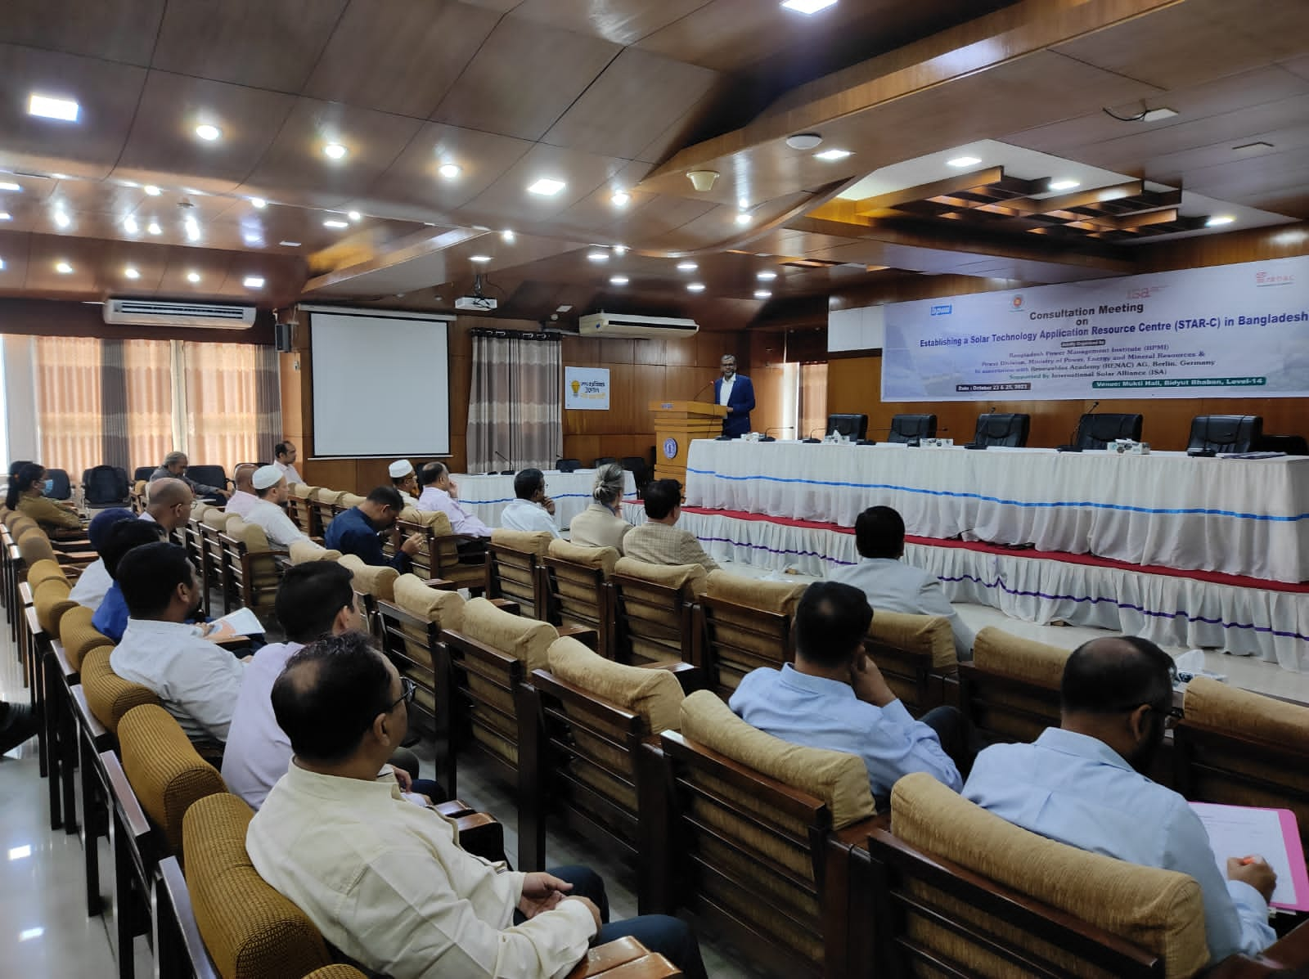
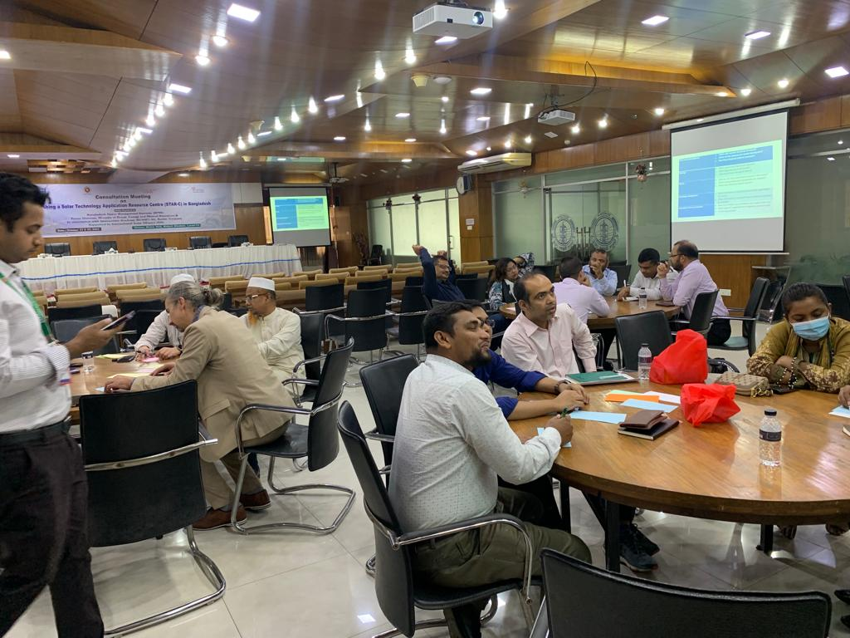
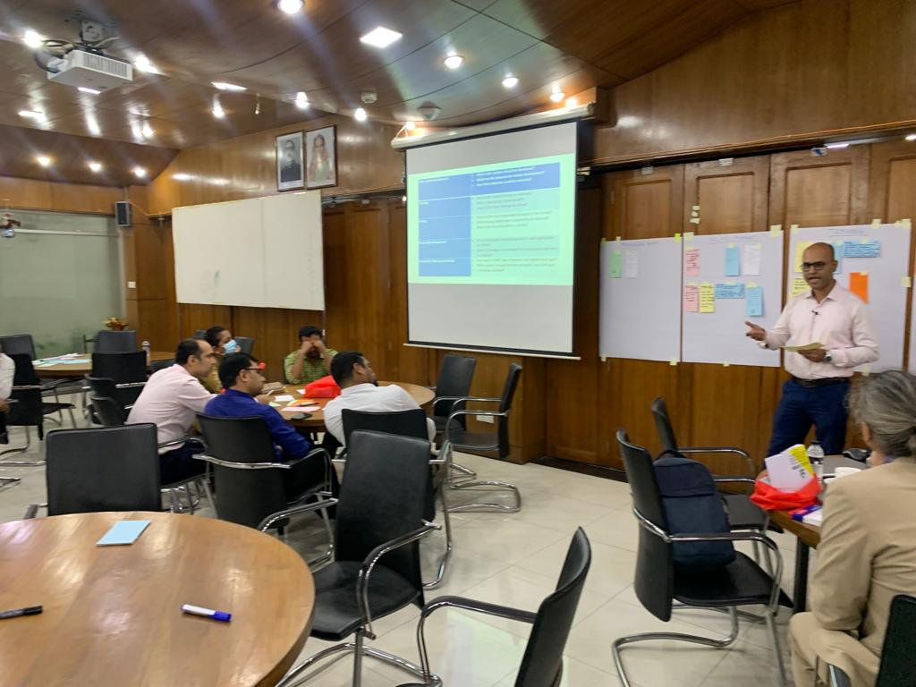
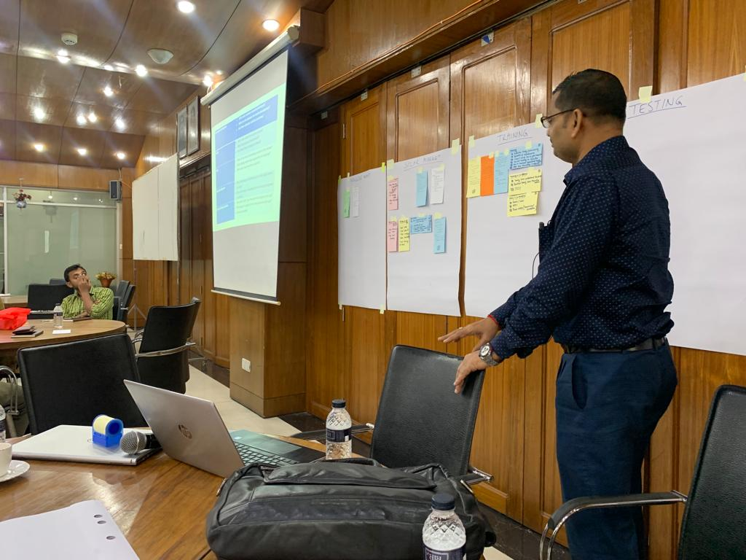
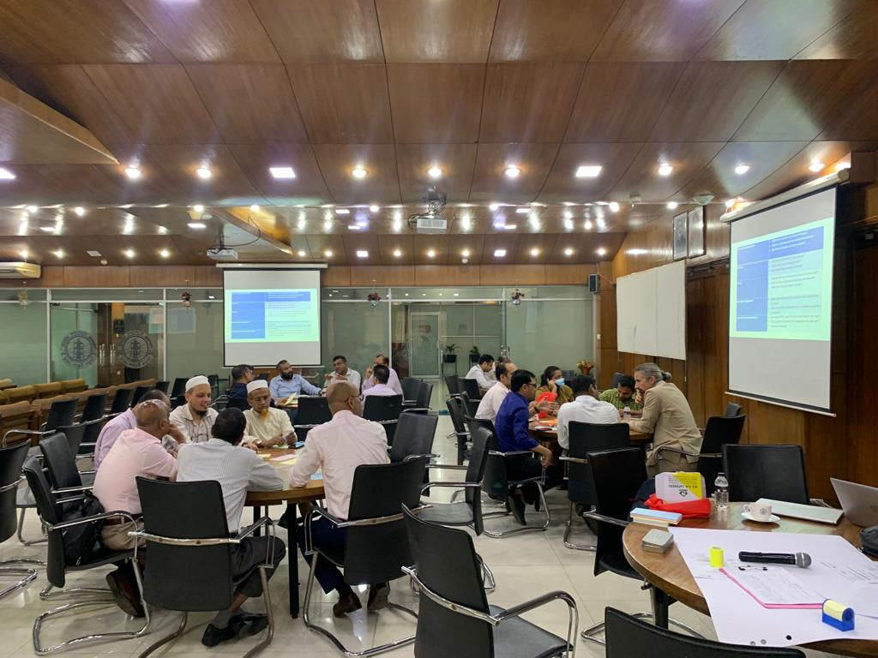
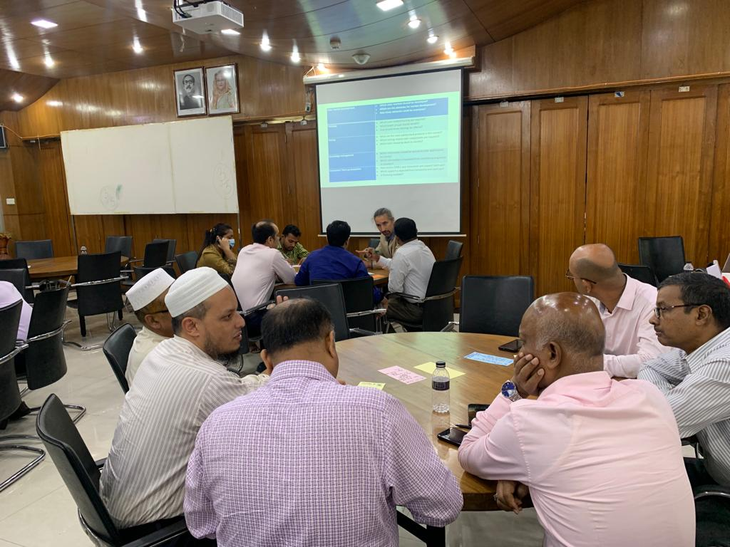
Consultation Workshop at Power Division (October 2023)

Slide 5
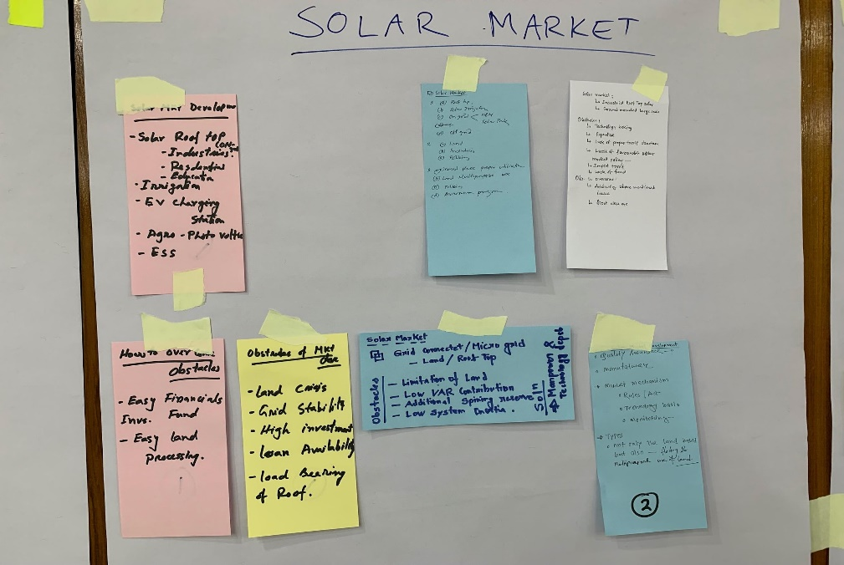
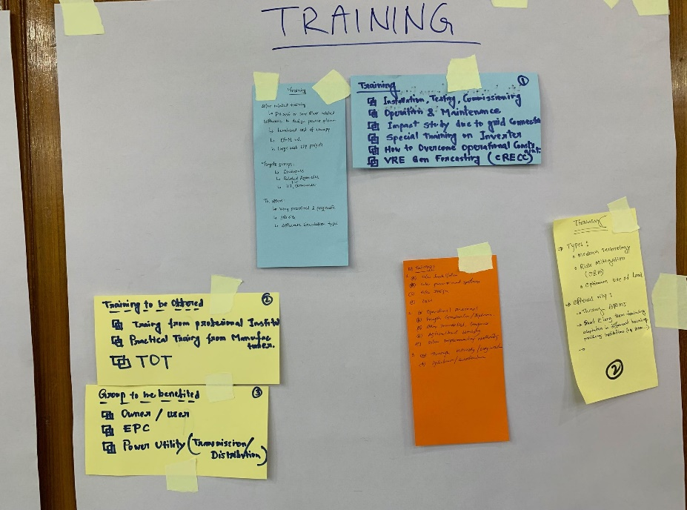
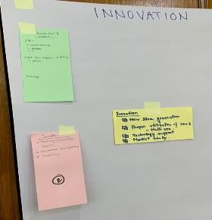
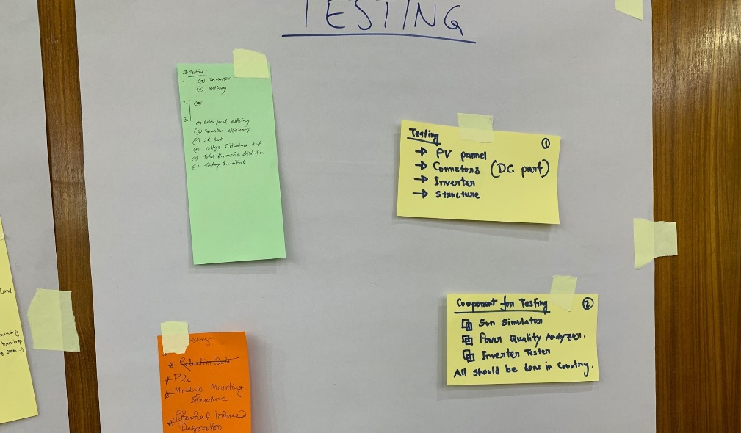
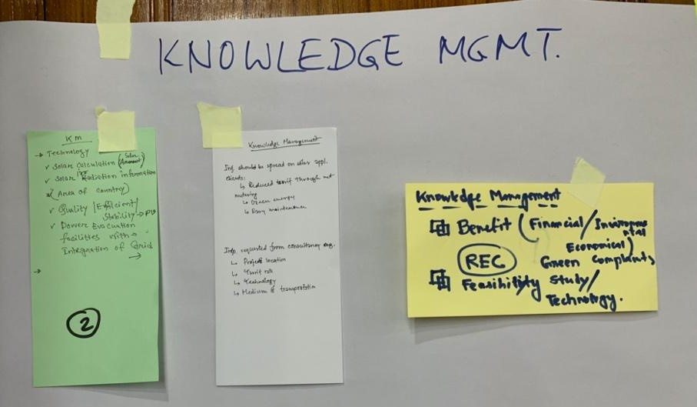
Shared Findings of Stakeholder Workshop

Slide 6
Interviews and Visits to Institutions
Ministry of Power, Energy and Mineral Ressources: Power Division
Bangladesh Power Management Institute (BPMI)
Bangladesh University of Engineering and Technology (BUET)
Bangladesh Institute of Standards and Technology (BSTI)
Bangladesh Rural Electrification Board (BREB)
Christian Commission for Development in Bangladesh (CCDB)
Bangladesh Solar and Renewable Energy Agency (BSREA)
National and Development Authority (NSDA)
Bangladesh Technical Education Board (BTEB)
Sustainable and Renewable Energy Development Authority (SREDA)
Private Sector Training Providers
Private Solar PV and EPC Companies
Donor Organisations
Notes:
- undertake country assessments for setting up Solar Technology Application Resource Centres in Bangladesh and
- develop a Detailed Project Report outlining the need of Bangladesh with respect to training, testing, innovation and knowledge generation; hardware/software requirement; human resources and a detailed business plan for STAR-C to generate revenue for sustenance.
Trina Solar, EPC‘s
SME Foundation

Slide 7
Main Findings (Gap Analysis)
Skills and education required for the large-scale solar PV industry are low in numbers when compared to the 5+ million Solar Home Systems that require O&M and repairs
Irrigation is a very much needed solar PV application that requires special training to set up efficient water supply systems for agriculture
Components for Solar Home Systems (batteries, PV modules, charge controllers) are sometimes of poor quality and contribute to e-waste. Repairs and O&M require special tools and training; challenging in rural areas.
E-mobilty (3-wheelers, rickshaw) deployment are 1+ million vehicles; synergies in O&M, charging, best practises of solar PV can help overcome grid supply shortages
Market development in solar PV sectors is evolving quickly but not reflected in time by educational institutions
Internship/Traineeship programmes for private companies need to be encouraged.
Notes:
simple testing without real certification
legal (private companies sued BUET because they have no mandate)
BSTI + SREDA (softens) = have the mandate

Slide 8
Main Findings (Gap Analysis)
Financing and project management skills are poorly addressed.
Low cost testing offers missing to get a first impression on product quality before being tested in accredited testing institution.
Lack of dissemination activities towards different potential client groups for solar PV applications.
Some supporting knowledge and dissemination activities are donor based and thus not continuously financed.
Innovation and business incubation activities for SMEs and start-ups not continuously offered and only partially related to PV.
Development of competency based training curricula for all skills levels (01 – 06 ) are missing.
Notes:
simple testing without real certification
legal (private companies sued BUET because they have no mandate)
BSTI + SREDA (softens) = have the mandate

Slide 9
Possible STAR-C Contributions to Gaps
Training offers
PV training courses are offered towards the main stakeholders of the solar value chain.
These courses should be registered at / certified by NSDA.
Offering PV training courses all over the country with local trainer pools.
Practical training on specific PV applications with hands-on training equipment.
Different solar applications showcased and monitored at STAR-C.
Increase in qualified personnel in the PV value chain (installer, engineering consultants, project developer, O&M, financing, grid operators, inspectors)
Better overall O&M and repair performance, especially in rural areas.
Promotion of energy efficiency for clients from industry & commerce.
Bridging rural e-mobility and grid integration (e.g. adapted charging regimes).
Notes:
In this slide please talk about what the STAR Centre aims to do to fill the gaps identified in the previous slide

Slide 10
Possible STAR-C Contributions to Gaps
Testing
Provide easy-to-implement quality checks (non-accredited) all over the country for O&M.
Establish a bridge also for low-cost devices for accredited testing at BSTI or BUET.
Dissemination
Increase the demand for solar PV by reaching potential target groups and clients for different applications.
Share best practise for solar PV application design and how to identify quality products.
Increase the supply for solar PV by providing sales persons with reliable information materials for end users and customers.
Innovation and incubation
Increase the ecosystem for innovation by promoting applied research and collaboration with private sector.
Foster the creation of jobs by guiding SMEs and start-ups to establish business in the solar sector.
Notes:
In this slide please talk about what the STAR Centre aims to do to fill the gaps identified in the previous slide

Slide 11
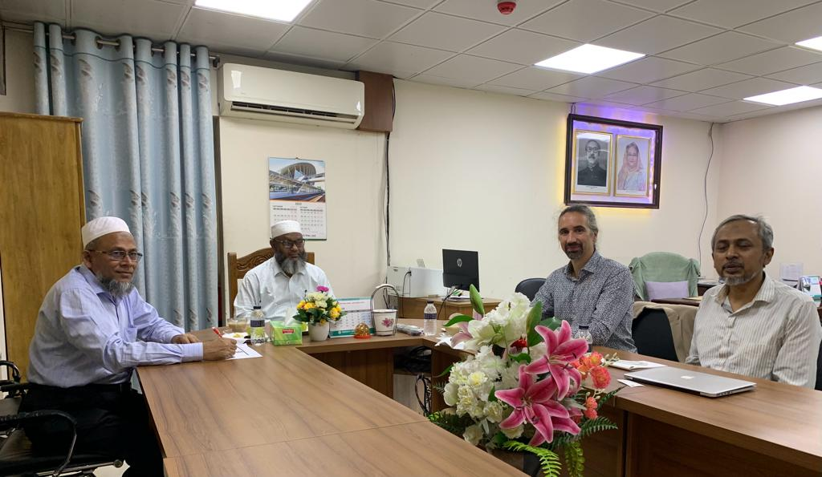
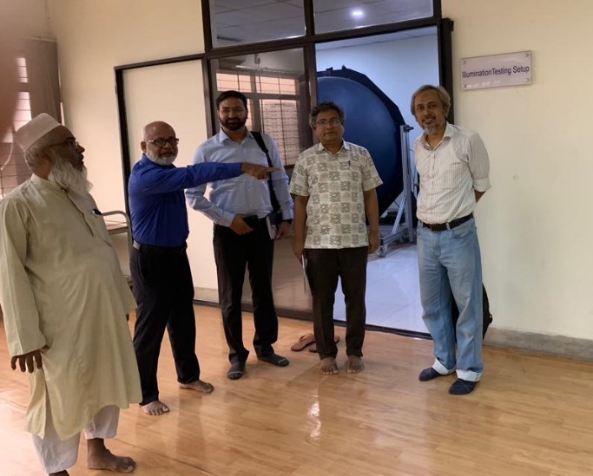
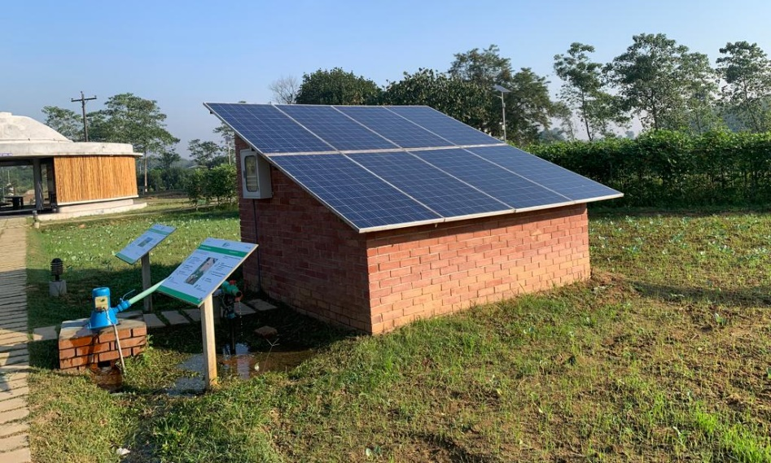
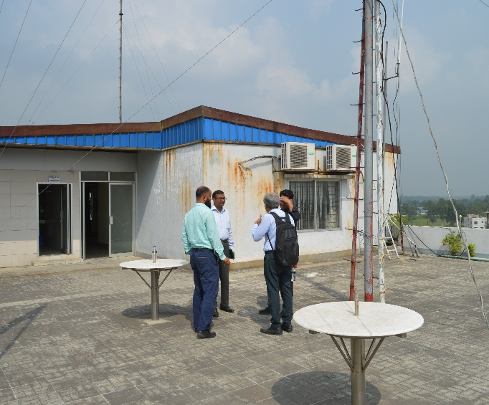
Country Assessment and Development of a Project Report

Slide 12
STAR-C: Training Concept
Main goal: skill sufficient qualified staff along the solar value chain in line with expected PV market development
Scope: modular trainings on technical, financial, legal aspects and best practices→ integrated solutions, quality of components and solar PV standards
Other relevant topics
Key: finance, green business and project development
Non-technical skills: sales, interpersonal and project management
Storage and connection to distribution grid
E-waste management, recycling and resource recovery
Target groups: project developers, technicians, engineers, economists, lawyers, trainers & testers, informal trained installers, policy makers, academics and end-users
Modes of training: modular, focused os refreshment/upskilling, also online/virtual trainings
Key: accessible to remote areas, women and youth
Notes:
approved

Slide 13
Training List (Examples)
Course Name | Target Group | Duration (Days)
Photovoltaic Technicians’ Training | Technicians | 20
Photovoltaic business development for Engineers’ Training | Engineers | 5
Train-the-Trainer - Seminar on Photovoltaic Energy | Professors, Trainers | 10
Policy framework and energy planning | Government | 5
Grid-connected photovoltaic (PV) systems: from project development to O&M | Project Developers, Government | 5
Project development, planning and feasibility of PV systems | Project Developers, Government | 5
Rooftop and open field photovoltaic in distribution grids | Engineers, Technicians | 3
Operation and maintenance of photovoltaic systems | Technicians | 5
Troubleshooting of photovoltaic systems | Technicians | 5
Green Energy Finance | Bankers | 3
Managing and financing PV projects | Bankers, Managers | 3
O&M for rural electrification and Solar Home Systems | Informally trained Technicians | 3
Notes:
Give example of trainings (online and physical) for Technicians, Government officers, bankers, universities etc. So that people attending the workshop can understand the kind of trainings that will be organised

Slide 14
STAR-C Training Concept
Short-term
National trainers: STAR-C trains trainers to carry out PV-technicians training, PV economics and sales training and PV-technical engineering training with final target group being:
technicians for installation, operation, maintenance,
engineers for system design, supervision of installation, monitoring, repair,
inspectors (from grid operators or conformity organisations),
sales persons and
economists for the system economics and sales.
International trainers: They will execute trainings for topics such as grid integration, storage, financing, policy frameworks, tendering and procurement which are relevant for the target
Policy makers
Public local authorities
Grid operators
Finance institutions
Project developers
Engineering consultants

Slide 15
Curricula Example

Slide 16
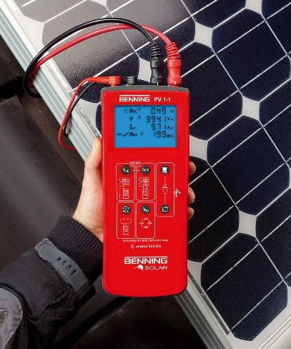
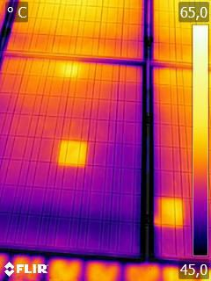
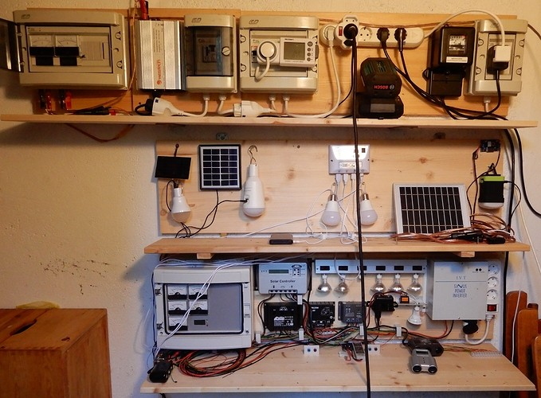
Testing
STAR-C as the platform to educate on product quality of PV components:
Low-cost testing equipment for first assessment of product quality
Training on the use of testing equipment
Offering testing for solar components (modules, inverters, batteries) to get a first impression on the quality of the products.
Advise on quality standards
If products seem to be of bad quality / under expectation: Further testing in accredited test laboratories.
Notes:
maybe testing images

Slide 17
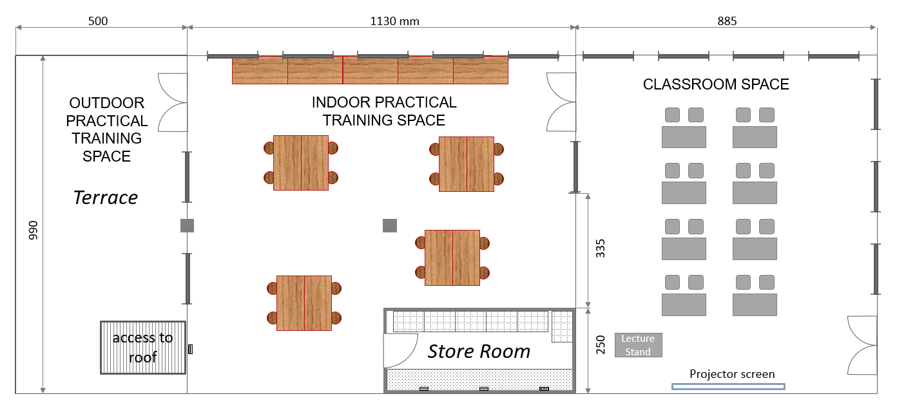
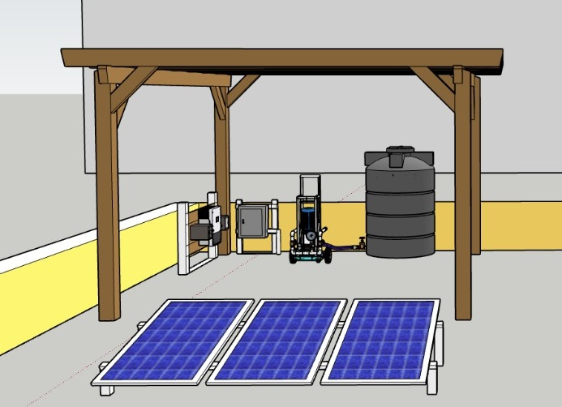
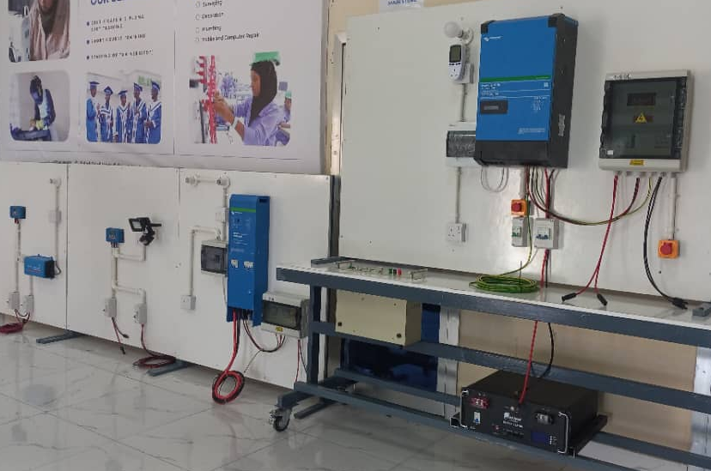
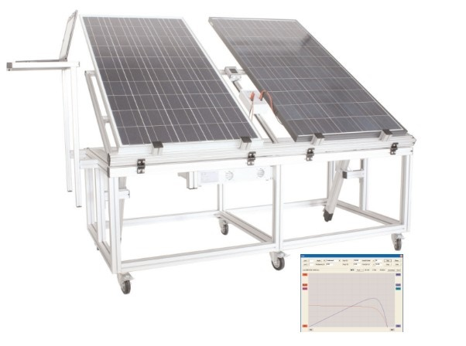
Training Center

Slide 18
Knowledge Management & Dissemination
In order to maximize benefits for the solar sector development, the knowledge dissemination approach of STAR-C will follow a holistic approach in several dimensions:
Topics: STAR-C will incorporate support on topics such as system design & integration, operation & maintenance, data management, business development, access to finance and customer relationship management.
Target groups: STAR-C will address target groups from the public, private and finance sectors, with special focus on stakeholders in rural areas.
Services: STAR-C needs to generate and disseminate information about different PV applications and their economics, costs of solar appliances, information on existing companies and quality assurance.
Information Events
Live information events and webinars on solar applications with STAR-C personnel and solar companies to present solutions and showcasing their experiences.
Notes:
1. knowledge management and dissemination will try to complement existing gaps in and objectives of the STAR-C not overlapping services.
2. SREDA is supporting to the customers on net metering rooftop solar for industry and end users from the commercial establishment.
3. Additional target groups can of course be identified during operation of each STAR-C; knowledge generation and dissemination activities can be adapted for and extended to these new target groups
what is offered and what STAR-C can do.
SREDA misses:
no information about different PV applications
economics of solar appliances
information for companies
introduction to system
GAP: no customer

Slide 19
Knowledge Management & Dissemination - Proposed Activities for STAR-C
Available information through the help desk from SREDA and BSTI:
Standards (offered by BSTI, SREDA)
Manuals (some offered by SREDA)
Feasibility studies, related information (offered by SREDA)
Regulations and policies (offered by SREDA)
Quality of technology (limited to non-accredited quality checks, mandate of BSTI)
Additional information provided from STAR-C
Solar resource and site-demand related
Relevant projects and applications
Reliable manufacturers and providers → key attractive for private sector involvement!
List of other relevant stakeholders, including testing and training facilities
Best practices
Funding information
Customer and end user awareness raising for solar PV
Notes:
what is offered and what STAR-C can do.
SREDA misses:
no information about different PV applications
economics of solar appliances
information for companies
introduction to system
GAP: no customer

Slide 20
Innovation and Incubation – Situation
SMEF and IDCOL already host business incubation programs or proposals. But these support programs are not continuously offered, only as long as donor funding is available.
Result: Insufficient support for solar SMEs and PV startups, including funding, mentorship, and access to incubation facilities.
Universities and technical vocational schools are still very much focused on technical skills and the practical training, which are mainly academic.
There is a gap between academia and private sector companies, due to absence of any cooperation mechanism.
Start-up platform to jump to private sector was not linked with industry associations.

Slide 21
Innovation and Incubation – Proposed Activities for STAR-C
Internship/Trainee programmes for private companies need to be encouraged.
Strategic planning, and business/sales/marketing related skills need to be emphasised.
Mentoring program on business development, intellectual property, strategic planning and business/sales/marketing related skills → incubation
Mentoring program on development of bankable project proposals.
Provide advisory services covering different options for productive use of energy.
Offer information and support for solar entrepreneurs to reach to the rural areas which are not yet covered by SREDA
Work together with SREDA and other actors, to foster innovation and incubation activities with SMEs.
Advise for proper use of land.

Slide 22
STAR-C Host Institution Proposal
Precondition for success of STAR-C in Bangladesh: collaboration with different actors already working in the solar sector like BSTI, BUET, BPMI, SREDA, CCDB, NSDA, BSREA, BEPRC, etc..
Bangladesh Rural Electrification Board (BREB)
The Bangladesh Rural Electrification Board (BREB) as ideal candidate for the set-up of a STAR-C in Bangladesh. BREB has the best potential for a national outreach with all its subsidiaries and experience in training and dissemination.
Mandate for training of public sector and private sector
Strong working relationship with power sector entities
Many subsidiaries all over the country
Available staff (hands-on trained) and management
Low administrative burden
Available place for training, testing
Accommodation and catering

Slide 23
Recommendations for the STAR-C Host Institution
Training
Important task of BREB will be to establish close cooperation with private sector solar companies to train according relevant job tasks of professionals.
Testing
The testing facility at BREB shall not be in competition to accredited testing institutions like BSTI or well equipped testing facilities like BUET. The low cost testing equipment enables component tests with modules, inverters or charge controllers which give a first indication on the functionality. After this first testing step clients can approach BSTI or other certified testing laboratories who can undergo internationally accredited testing procedures.
Dissemination
Dissemination activities will be complementary to the National Solar Helpdesk organized by SREDA.
Innovation / Incubation
STAR-C will work together with Bangladesh Energy and Power Research Council (BEPRC) to foster innovation and incubation activities with SMEs.

Slide 24
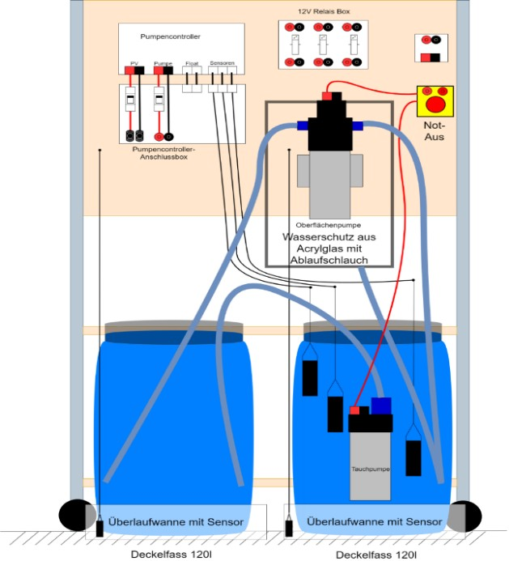
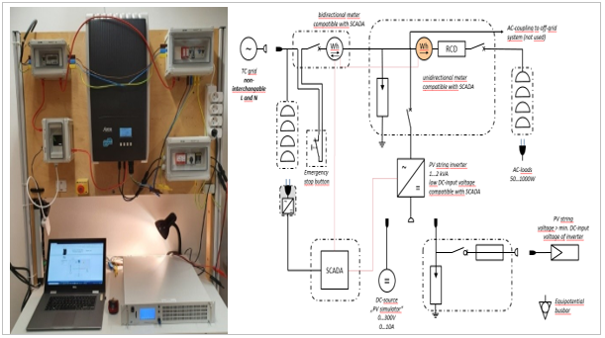
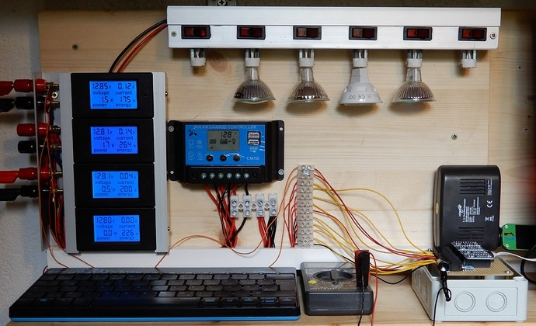
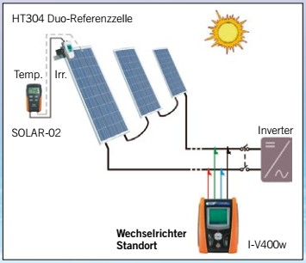
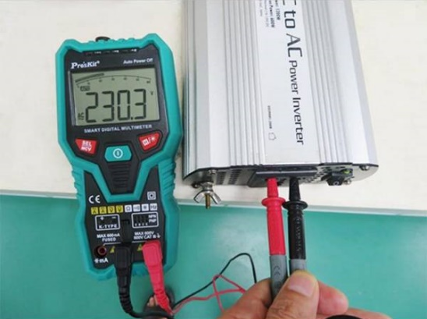
Training rigs, hardware and software, tools

Slide 25
Expectations for a Successfully Established STAR-Centre (4 Years)
Training
A variety of either customized or short-term courses registered at NSDA.
Increase in qualified personnel in solar PV.
Better overall O&M and repair performance, especially in rural areas.
Testing
Quality checks (non-accredited) of different PV components are offered.
A collaboration with BSTI and BUET will be established if major quality issues are spotted, e.g. inefficient LED lamp solutions, low quality of solar components.
Develop repair guides based on QA checks.
Minor quality products (also poorly written manuals) will be reported.
Provide easy-to-implement quality checks (non-accredited) in rural areas for O&M.
Notes:
In this slide, please highlight what is envisaged to change in next 3-4 years by having a STAR Centre

Slide 26
Expectations for a Successfully Established STAR-Centre (4 Years)
Dissemination
Reliable manufacturers and providers for solar PV will be identified and shared.
A network of key stakeholders in solar PV exists, including testing and training facilities.
Best practices and application are shared within the community of STAR-C and beyond.
Funding information is made public in close collaboration with SREDA, also for customers (home-owners, farmers) and end user awareness raising, net-metering and general economics for solar PV.
Data collection and analysis of solar installations in the country.
Innovation and Incubation
SMEs and start-ups supported in business plan development and entrepreneurship skills.
Provide maker and lab space for entrepreneurs, concept developers.
Organise ‘hackathons’ with private sector participation.
Connect entrepreneurs with private sector players for financing of project ideas or access to internships.
Notes:
In this slide, please highlight what is envisaged to change in next 3-4 years by having a STAR Centre

Slide 27
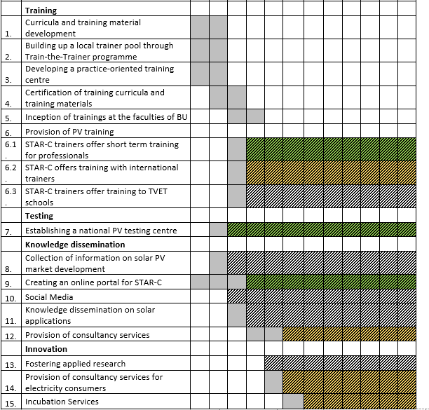
Timetable

Slide 28
Open Forum and Q&A

Slide 29
Closure
Structuring of an International Solar Technology and Application Resource Centre (STAR-C) in Bangladesh
Strong network of institutional capacities within ISA Member States to enhance quality infrastructure for the solar energy markets

Slide 30
Thank you
Because the sun never really sets…

